Slide 1
Ethics, Values, and Morals

Slide 2
How much information do you already know about this topic area?
Expert - I have done a lot of learning in this area already.
Above average - I have learned some information about this topic.
Moderate - I know a little about this topic.
Rookie - I am a blank slate…but ready to learn!
1
1
1
1
(LE100-C1L5:LQ1)

Slide 3
Which of the following is one of the four types of values?
Self
Personal
Unconventional
Professional
1
1
1
1
(LE100-C1L5:LQ2)

Slide 4
Lesson Overview
Ethics
Values
Core values of the US military services
Cultural and universal norms
Making ethical and moral decisions
Your personal code of conduct

Slide 5
Vocabulary Questions Slide Index
Click any link below to go directly to polling that question.
Study of the mind/behavior
Study of people's beliefs and how these beliefs are justified
Rules of conduct that people should follow
Free of favoritism
Closely following a consistent code of ethics
Our set of ideals that we use every day to make decisions
Our behavior, right or wrong
Click here to return to this index.

Slide 6
Vocabulary Questions Slide Index
Click any link below to go directly to polling that question.
Patterns of behavior considered acceptable by a social group
Normal beliefs of people in most cultures
Values toward which some people may feel a serious personal obligation
Awareness of a desire to act properly and the awareness of guilt when improper acts are committed
Click here to return to this index.

Slide 7
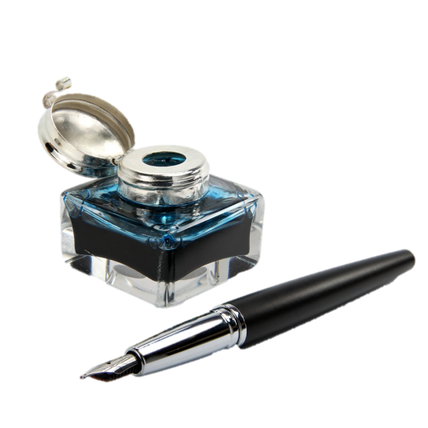
Quick Write
Your best friend wants you to go with him/her to have some fun tonight. Jot down three personal guidelines you would use to decide whether it would be right or wrong to go with them.
Note to Instructors:
Click the Show/Hide Response Display Button
Photo Courtesy of Fotolia

Slide 8
Let’s get something clear ….
What we allow ourselves to watch, listen to, and read, impacts the way we think.
The way we think influences what we believe and what we value. What we believe influences the way we behave – our actions.
Think + Belief = Actions

Slide 9
Ethics
Rules of conduct that people should follow
Helps us decide whether something is right or wrong
Assumes we have the free will to make decisions and act on those decisions
Photo Courtesy of Fotolia

Slide 10
Ethics: A system of moral principles; the branch of philosophy dealing with human values and moral conduct. The science (The study) of moral duty.
Ethical: Conforming to moral standards. Conforming to standards of a profession.

Slide 11
Four Basic Rules of Ethics
Do good; avoid evil
Be fair and unbiased
Respect the dignity of all people
Be responsible for your thoughts and conduct
Photo Courtesy of Fotolia

Slide 12
Ethics and Personal Standards
Moral beliefs are actually habits learned as children
Adults develop habits over their lifetime
Not all habits are right
Be tolerant of other people’s concepts, beliefs, and feelings
Photo Courtesy of Fotolia

Slide 13
Concern for Others and Integrity
Concern for Others
Our physical needs must be satisfied first
Then we move on to higher-level needs
Integrity
We should display in our daily activities
Do what’s right whether someone is watching or not
Have a disciplined, balanced approach to life
Photo Courtesy of Fotolia

Slide 14
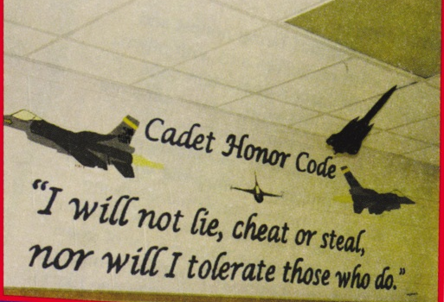
Ethical Qualities and Professional Standards
Ethical Qualities of Effective Leaders
Success requires a great deal of self-discipline and personal stability
All leadership decisions have ethical aspects and require moral judgment
Professional Standards
Each profession has standards that members are expected to follow

Slide 15
Right Choices
Right choices build confidence and self-respect
Distinguishes effective leaders from average or poor leaders
Leaders who make right choices show ethical courage and maturity
Photo Courtesy of Fotolia

Slide 16
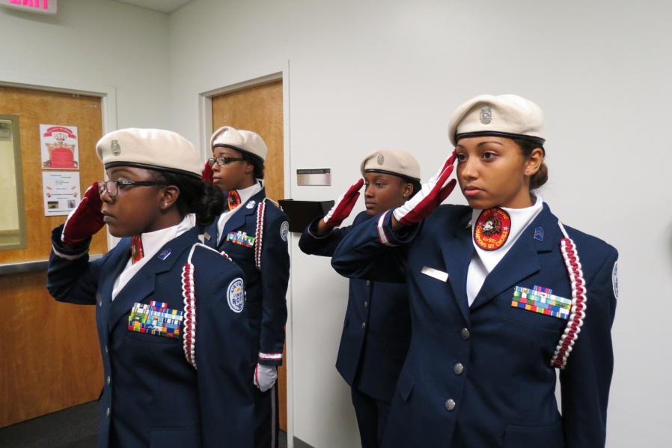
Rules and Principles of Ethical Decisions
Greatest influence on our ethical decisions
Primary ethical standards are telling the truth, keeping promises, and respecting people and property
Photo Courtesy of Michael Wetzel/US Air Force JROTC

Slide 17
Aristotle & Virtue Theory: Crash Course Philosophy #38
This video will help us understand values – what’s important to us
https://youtu.be/PrvtOWEXDIQ

Slide 18
Which of the following is one of the four basic rules of ethics?
Do evil
Be biased
Don’t harm others
Be responsible
1
1
1
1
(LE100-C1L5:LQ3)

Slide 19
Most decisions require judgment that is influenced by a leaders own:
values, character, and background
skills, character, and background
skills, values, and character
values, background, and respect
1
1
1
1
(LE100-C1L5:LQ4)

Slide 20
Values
Our beliefs about what is and is not important
Involves freely chosen behavior based on values we believe are important
What we have learned and experienced
Our beliefs are personal to each of us
Photo Courtesy of Fotolia

Slide 21
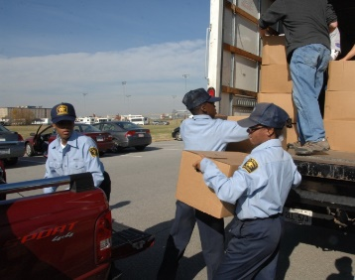
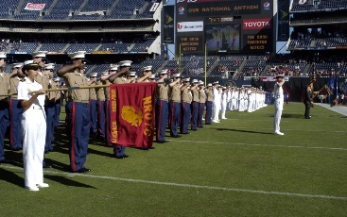
Four Types of Values
Types:
Personal Values
- Things you have learned from parents, friends, church, and school
- Such as freedom, happiness, equality, and peace.
- For military personnel, there are conflicts between what we value and what the military needs.
Photo Courtesy of Joseph P. Cirone/Defense Video & Imagery Distribution System
Photo Courtesy of Petty Officer 1st Class Maurice Dayao/Defense Video & Imagery Distribution System

Slide 22
Prudent Values
- Involves using good judgement when considering a course of action.
- Staying out of trouble with the law
Taking care of you physical and mental health
- Saving money for college instead of buying the latest electronic craze

Slide 23
Conventional Values
- Those accepted within a social order
- These are binding upon members of that social order
- Some examples would don’t steal, kill, and showing respect to elders

Slide 24
Moral Values
Rooted in a comprehensive view of human life, social living, and view of the ultimate purpose and meaning of life.
Morals refers to our behavior, good or bad, right or wrong.
- The source of our morals date back to Greek and Roman philosophy and the Judeo-Christina ethic – like the Ten Commandments and the golden rule
We also use rules, ethical, and values to help make ethical decisions. They work together.

Slide 25
Activity 1: A Current Ethical Dilemma
Break into small groups
Read the ethical dilemma.
Form an opinion about the ethical choices, decisions, and consequences
Answer the three questions presented

Slide 26
When making an Ethical decision, ask yourself the following:
1. Is it legal?
-- Not just talking about civil or criminal laws.
-- Includes company policy.
--- Not doing something that is or gives the appearance of being illegal, improper, or immoral.

Slide 27
2. Is it balanced?
-- What is meant, is the decision fair or will it heavily favor a group of people over another in the short or long term.
-- Will there be a BIG winner or BIG loser?
-- If not balanced, it will probably come back to haunt you.

Slide 28
3. How will it make me feel about myself?
-- Unethical acts will erode your self-esteem. (No amount of money or power is worth that.)
--- Would you want your decision published in a major newspaper or shown on the nightly news?
“There is no pillow as soft as a clear conscience.”

Slide 29
Core Values of the US Military Services
Air Force: Integrity first, Service before self, and Excellence in all we do
Army: Loyalty, Duty, Respect, Selfless Service, Honor, Integrity, and Personal Courage
Navy and Marine Corps: Honor, Courage, and Commitment
Coast Guard: Honor, Respect, and Devotion to Duty
Photo Courtesy of Fotolia

Slide 30
Air Force Core Values
Integrity First:
The willingness to do what is right even when no one is looking.
B. Character traits associated with integrity
1. Courage: do what’s right even if personal cost is high

Slide 31
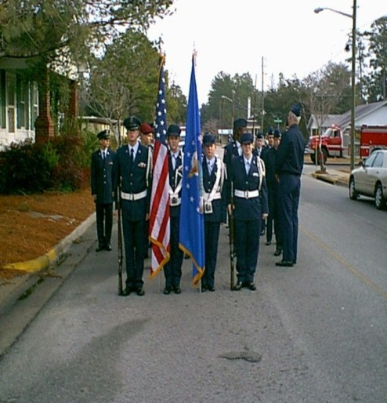
2. Honesty: your word must be your bond
3. Responsibility: be capable and dependable
4. Accountability: you take credit for better or worse – you answer for it
5. Openness: encourage free flow of information within an organization
6. Self-respect: respect one’s self as a professional and human being; don’t behave in ways to bring discredit upon yourself or organization

Slide 32
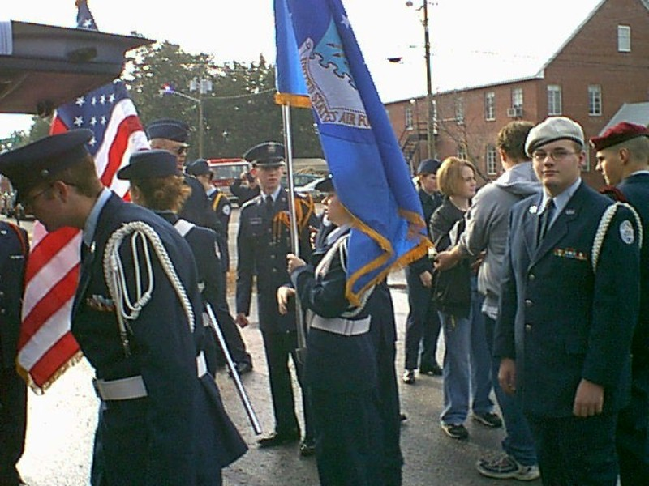
7. Humility: modesty or meekness in behavior and attitude

Slide 33
2. Service before self:
Professional duties take priority over personal desires
B. Behavior associated with service before self
1. Rule following: understand rules exist for a reason and you must follow them unless safety or morality is at stake
2. Respect for others: place troops ahead of your personal comfort

Slide 34
3. Discipline and self-control: don’t indulge yourself in self-pity, discouragement, anger, frustration or defeatism – don’t become a victim – causes you to think too much about yourself and not others
4. Faith in the system: don’t adopt the view that you know better than those above you in the chain of command what should or should not be done

Slide 35
Excellence: Excellence is an inner drive to be the best you can be. This desire to excel is what changes ordinary people into extraordinary individuals.
3. Excellence in all we do:
A. Excellence in all we do: develop a sustained passion for continuous improvement and innovation that will propel the Air Force into a long-term, upward spiral of accomplishment and performance

Slide 36
Types of Excellence:
1. Personal excellence
2. Community excellence
3. Resources excellence
4. Operations excellence

Slide 37
Activity 2: Core Values of the US Military Services
Identify the similarities of the core values within two US Military Services
Provide an example of when you have lived one of the values in your personal life. In other words, do you have an example where lived out integrity?

Slide 38
Cultural and Universal Norms
Cultural Norms: All societies have morals, values, and concepts of human rights
Customs and values depend upon the culture in which we live
Universal Norms: An obligation to honor constitutional justice, civil law, and the moral norms of our communities
Non-universal norms do not carry a universal moral obligation

Slide 39
Which of the following is one of the four types of values?
Moral
Respect
Devotion to Duty
Selfless Service
1
1
1
1
(LE100-C1L5:LQ5)

Slide 40
Which norm does not carry a universal moral obligation?
Cultural Norms
Universal Norms
Non-universal Norms
Non-cultural Norms
1
1
1
1
(LE100-C1L5:LQ6)

Slide 41
Making Ethical and Moral Decisions
Four steps to help make the right ethical and moral decisions:
Consider all the facts
Determine the moral values or rules that apply to the situation
Always make decisions and act in light of your knowledge of the values and facts
Choose the lesser of two evils
https://youtu.be/BgZr1_86Ycw
Photo Courtesy of Fotolia

Slide 42
Moral Courage and Maturity
“To know right from wrong, to possess a firm set of values, and the strength to live by those values and do what is right regardless of the consequences”
You should already possess a conscience, a sense of justice, and a personal code of conduct

Slide 43
Conscience and Sense of Justice
Conscience
A product of knowledge and intelligence
Allows us to judge right from wrong
Strengthened as our knowledge increases
Sense of Justice
Essential for effective leaders
Developed from learning experiences over time
Photo Courtesy of Fotolia

Slide 44
Activity 3: Ethics – Everyone Else Does It!
Review and discuss your assigned ethical dilemma
Determine how to make a decision about the dilemma
Answer the questions about your ethical dilemma

Slide 45
Activity 4: “What Would You Do?” Role-Play
Choose a “persuader” and “participant” for the activity
The “persuader” will read the scenario and the “participant” will react to the scenario in front of the class

Slide 46
Personal Code of Conduct
It should be a list of reminders that cause us to practice acceptable behavior
Developing permanent good habits is very important
Photo Courtesy of Fotolia

Slide 47
Forming Good Habits
To get rid of bad habits and form good ones:
Begin the change in behavior as strongly as possible
Never stop a new habit before it is firmly fixed in your life
Take every chance you get to act on the change
Photo Courtesy of Fotolia

Slide 48
What is one of the four steps to help you make the right ethical and moral decisions?
Consider only the relevant facts
Determine the moral values or rules that apply to the situation
Always make decisions based on your instinct
Make sure you wait at least 24 hours before making a decision
1
1
1
1
(LE100-C1L5:LQ7)

Slide 49
What step should be used to get rid of bad habits?
Begin on a Monday
Never stop a new habit within the first 7 days
Take every chance you get to act on the change
Make sure your friends also change the bad habit
1
1
1
1
(LE100-C1L5:LQ8)

Slide 50
Activity 5: “Remember the Titans”
Watch the movie “Remember the Titans”
During the movie, take notes and give a brief example for each situation by referring to a scene in the movie

Slide 51
Summary
Ethics
Values
Core values of the US military services
Cultural and universal norms
Making ethical and moral decisions
Your personal code of conduct

Slide 52
How will making ethical and moral decisions allow you to become a better person?
Note to Instructors:
Click the Show/Hide Response Display Button
(LE100-C1L5:LQ9)

Slide 53
What parts of this lesson were the hardest to understand? What parts were the easiest?
Note to Instructors:
Click the Show/Hide Response Display Button
(LE100-C1L5:LQ10)

Slide 54
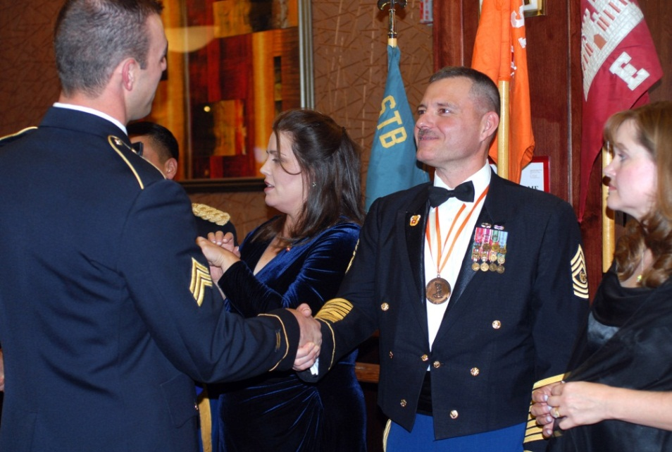
Next….
Done – ethics, values, and morals
Next – social etiquette and Dining-in, Dining-out
Photo Courtesy of Army Staff Sgt. Carlos M. Burger II/Defense Video & Imagery Distribution System

Slide 55
Team Assignment
Alpha
Bravo
Charlie
Delta

Slide 56
The study of the mind and of behavior
Ethics
Value system
Philosophy
Psychology
1
1
1
1
(LE100-C1L5:VQ1)

Slide 57
The study of people's most fundamental and basic beliefs and how these beliefs are justified
Ethics
Value system
Philosophy
Psychology
1
1
1
1
(LE100-C1L5:VQ2)

Slide 58
The rules of conduct that people should follow
Ethics
Value system
Philosophy
Psychology
1
1
1
1
(LE100-C1L5:VQ3)

Slide 59
Free of favoritism
Norms
Morals
Unbiased
Universal norms
1
1
1
1
(LE100-C1L5:VQ4)

Slide 60
Being honest and sincere with ourselves and with others, closely following a consistent code of ethics
Morale
Integrity
Morals
Conscience
1
1
1
1
(LE100-C1L5:VQ5)

Slide 61
Our set of ideals, beliefs, interests, likes, and dislikes that we use every day to make decisions
Ethics
Value system
Philosophy
Psychology
1
1
1
1
(LE100-C1L5:VQ6)

Slide 62
Our behavior, right or wrong
Morale
Integrity
Morals
Conscience
1
1
1
1
(LE100-C1L5:VQ7)

Slide 63
Patterns of behavior considered acceptable or proper by a social group
Norms
Morals
Universal norms
Non-universal norms
1
1
1
1
(LE100-C1L5:VQ8)

Slide 64
The normal beliefs of people in most cultures
Norms
Morals
Universal norms
Non-universal norms
1
1
1
1
(LE100-C1L5:VQ9)

Slide 65
Values such as duties specific to one's religion toward which some people may feel a serious personal obligation
Norms
Morals
Universal norms
Non-universal norms
1
1
1
1
(LE100-C1L5:VQ10)

Slide 66
The awareness of a desire to act properly and the awareness of guilt when improper acts are committed or intended
Morale
Integrity
Morals
Conscience
1
1
1
1
(LE100-C1L5:VQ11)

Slide 67
Leaderboard
Last
Slide
Points | Participant | Points | Participant

Slide 68
Team Scores
Last
Slide
Points | Team | Points | Team

Slide 69
Team MVP
Last
Slide
Points | Team | Participant

Slide 70
Whiteboard
Last
Slide

